Slide 5
A
B

Slide 6
A
B
Notes:
Figure X: An approximate maximum likelihood phylogeny of C. glabrata (A) and C. albicans isolates (B) including our THRIVE isolates (red labels) and other globally collected strains (black labels). The physiological sites of isolation are indicated as a colour strip around the phylogeny showing rectal (brown) , vaginal (purple) and all other sites (grey).

Slide 7
A
B
Notes:
Figure X: An approximate maximum likelihood phylogeny of C. glabrata (A) and C. albicans isolates (B) including our THRIVE isolates (red labels) and other globally collected strains (black labels). The physiological sites of isolation are indicated as a colour strip around the phylogeny showing rectal (brown) , vaginal (purple) and all other sites (grey).

Slide 8

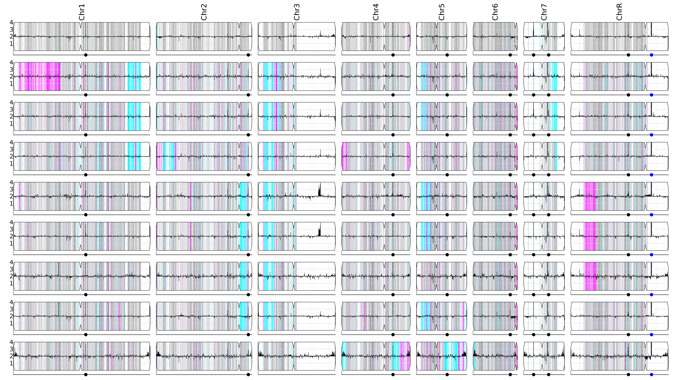
A
YST6
B
SC5314
TVY10V11
TVY10V13
TVY10R14
TVY10R11
TVY10R12
TVY10R13
TVY10V10
TVY10V12
TVY4
YST7
9518
B116
M17
Niger8

Slide 9
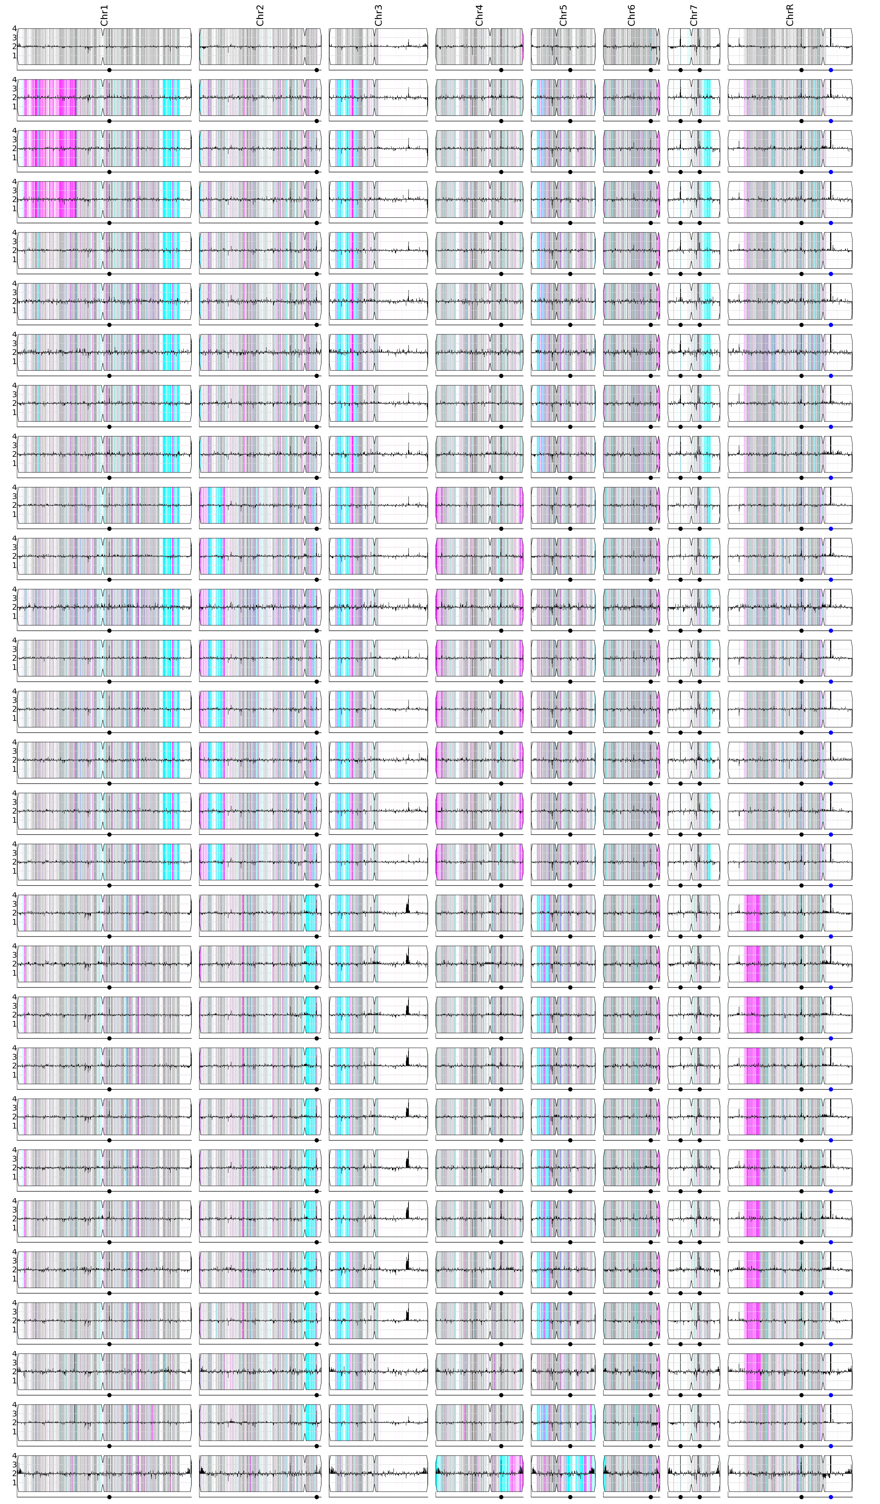

Slide 10
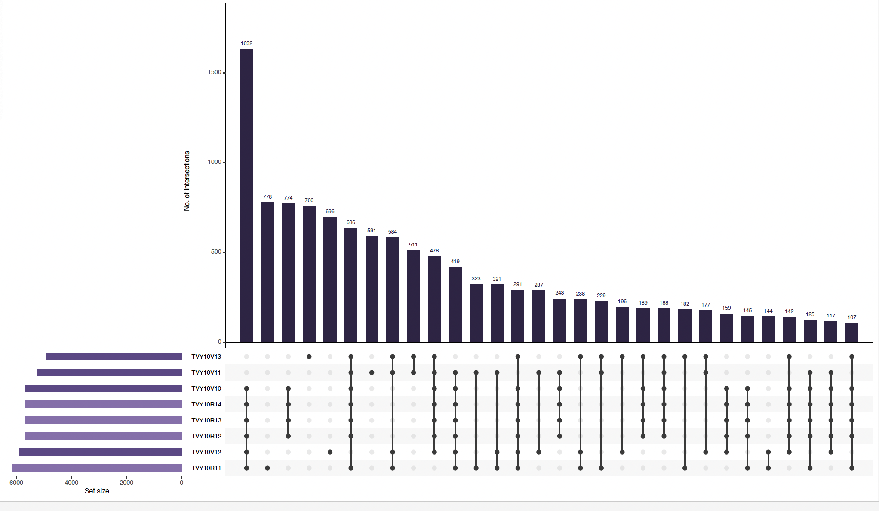
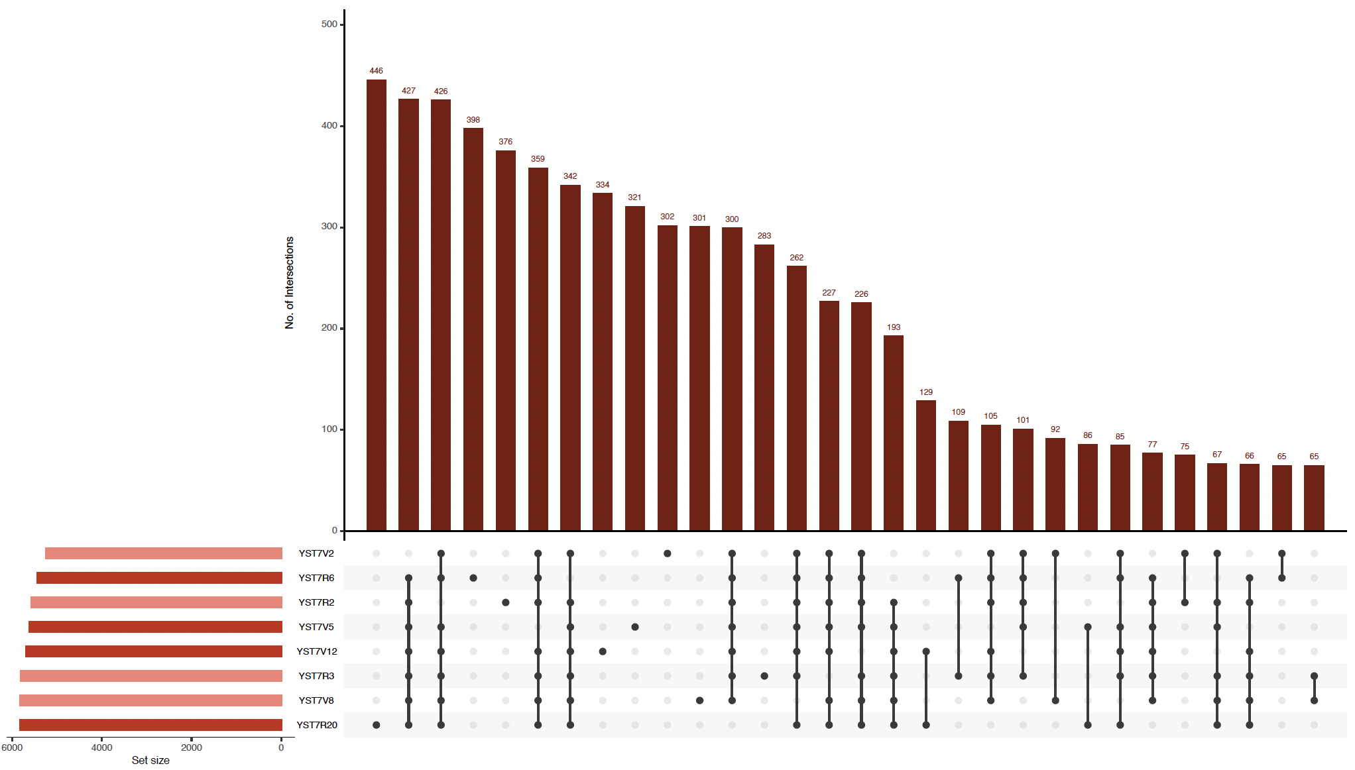
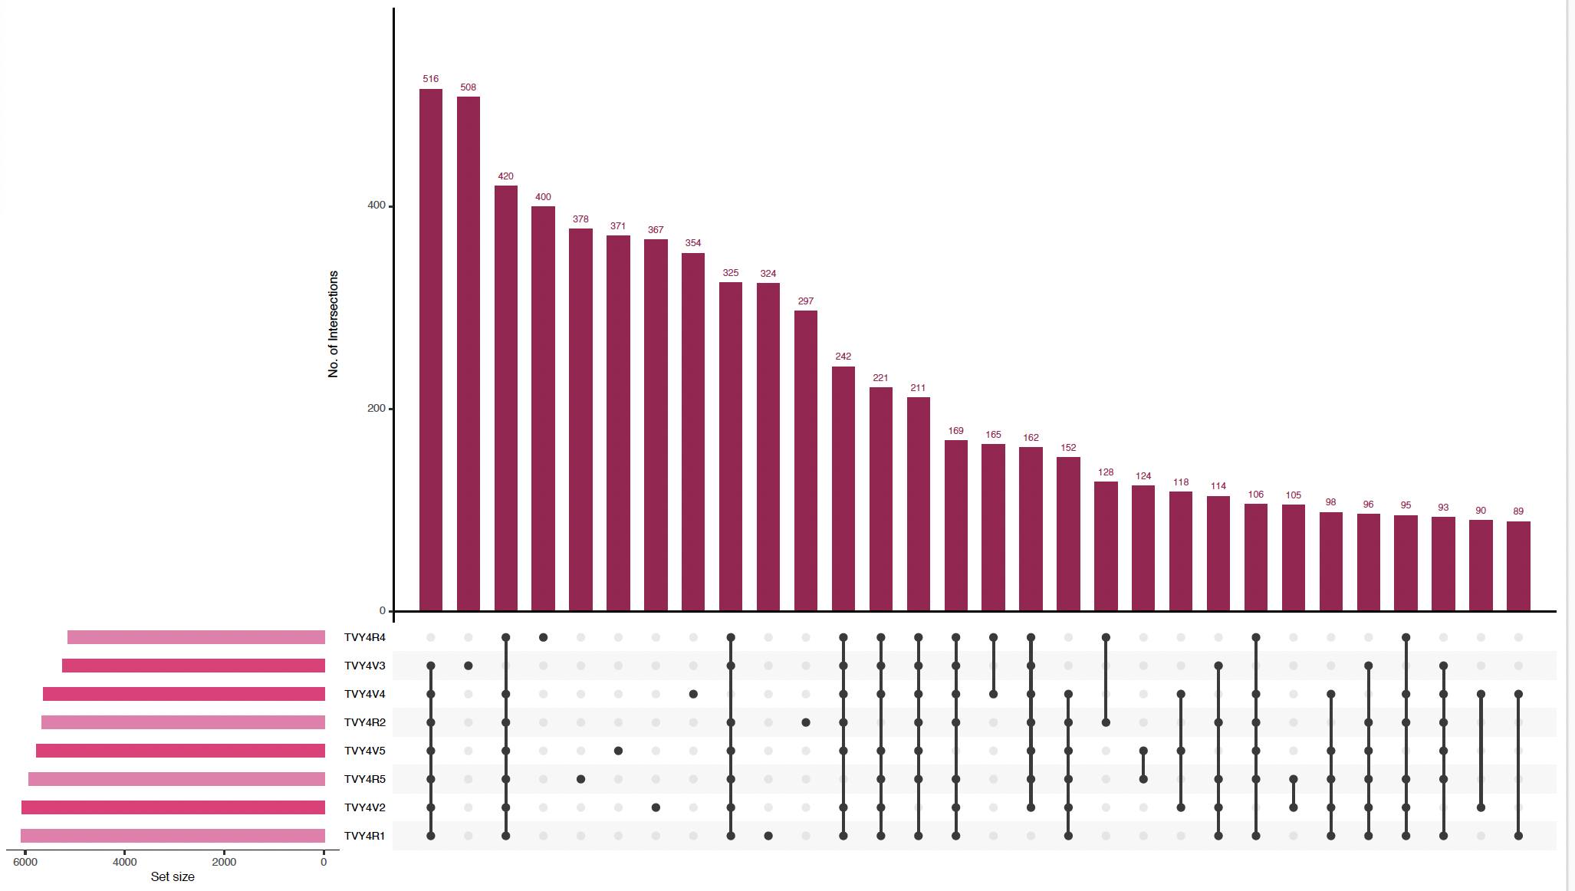
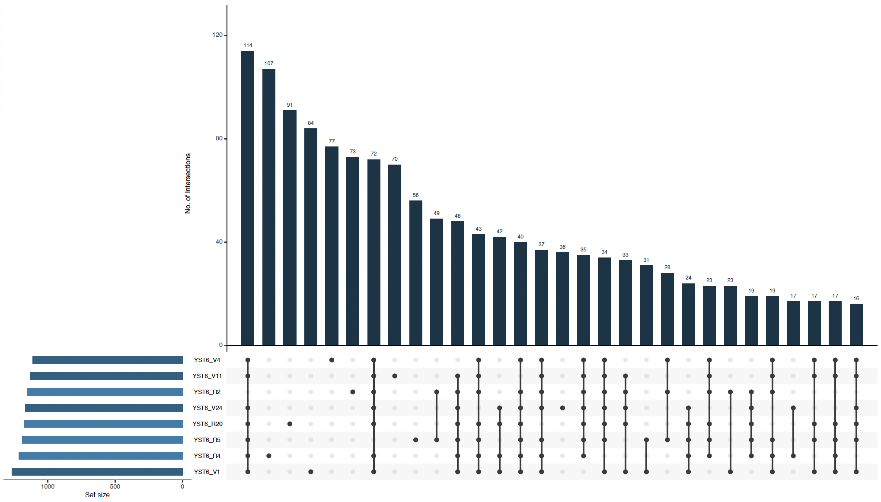
B
A
C
D

